Slide 1
SWAT+ Workshop
Global Data Sources
Dr. Celray James CHAWANDA

Slide 2
Main input data
DEM
Landuse
Soil map
Climate data
Crop Phenology
Reservoirs
Observation Data

Slide 3
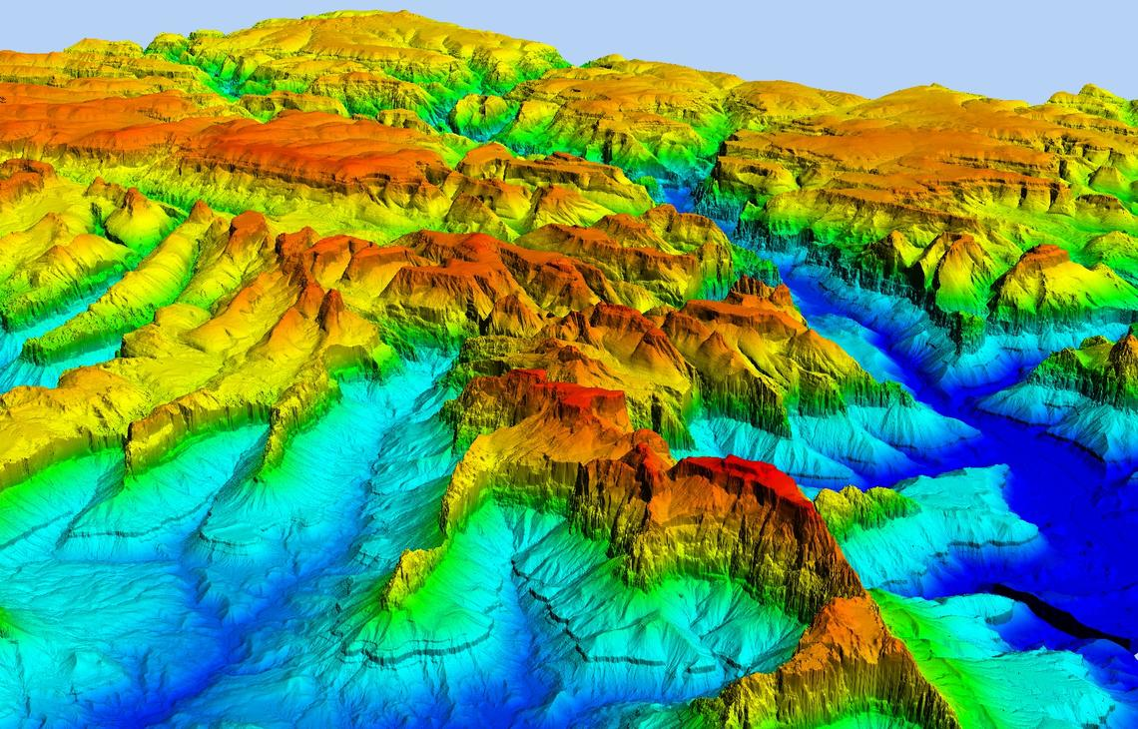
DEM…
(Digital elevation model)
Representation of the bare ground (bare earth) topographic surface of the earth excluding trees, buildings, and any other surface objects.
Common sources
Space Shuttle Radar Topography Mission (SRTM)
ASTER Global Digital Elevation Model
Download from USGS Earth Explorer
3

Slide 4
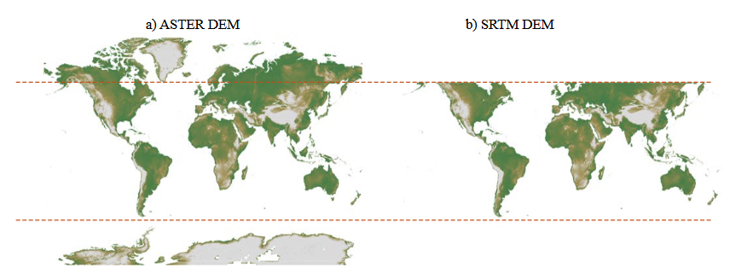
DEM…
(Digital elevation model)
Representation of the bare ground (bare earth) topographic surface of the earth excluding trees, buildings, and any other surface objects.
4

Slide 5
Main input data
DEM
Landuse
Soil map
Climate data
Observation Data

Slide 6
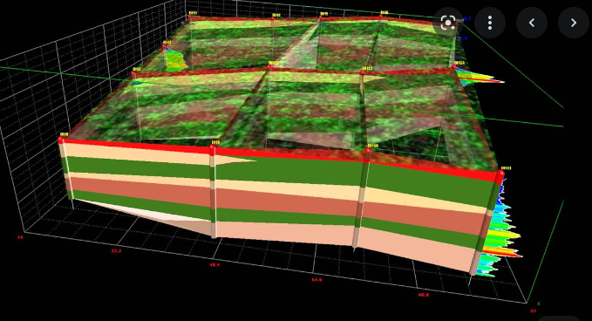
Soil…
Spatial geographical representation showing diversity of soil types and/or soil properties (soil pH, textures, organic matter, depths of horizons etc.)
Common sources
FAO UNESCO Soil Map of the World (SMW)
{Harmonized World Soil Database (HWSD)}
At a global level, only one generally accepted global soil map (Dai et al., 2019)
6
Notes:
At the regional and national levels, there are many soil maps based on either national or international soil classifications e.g AfSIS for Africa, SOTEr for Europe etc

Slide 7
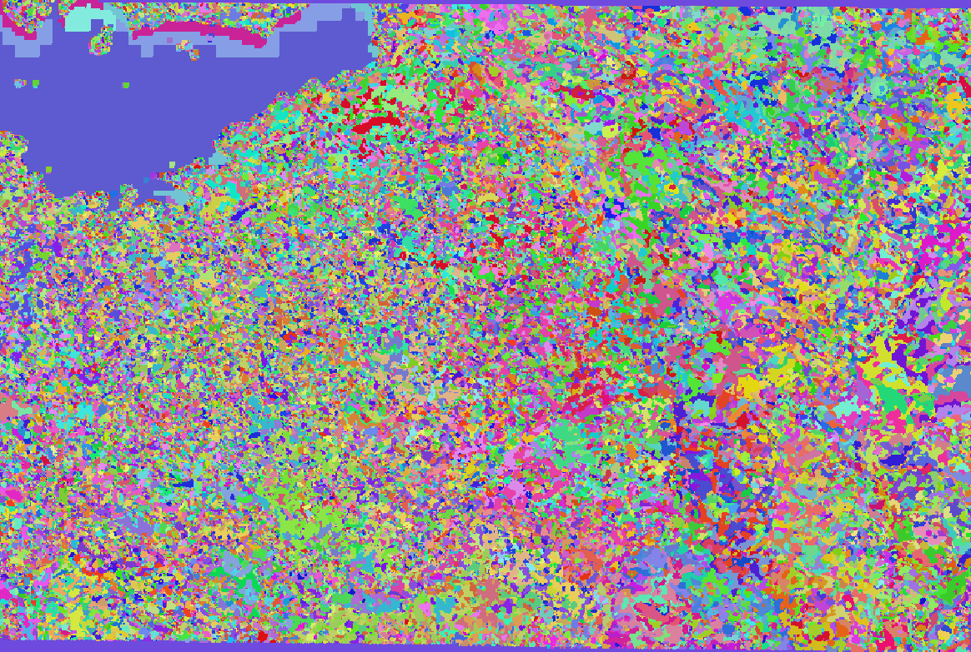
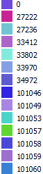
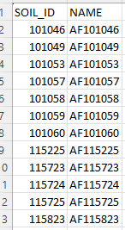
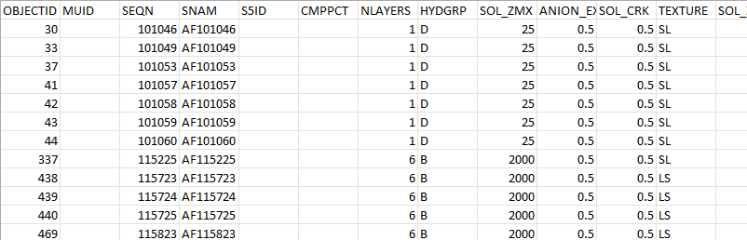
Soil…(e.g)
Raster soil
soil ID
SWAT soil lookup table (.csv)
SWAT usersoil table (.csv)
7
Notes:
At the regional and national levels, there are many soil maps based on either national or international soil classifications e.g AfSIS for Africa, SOTEr for Europe etc

Slide 8
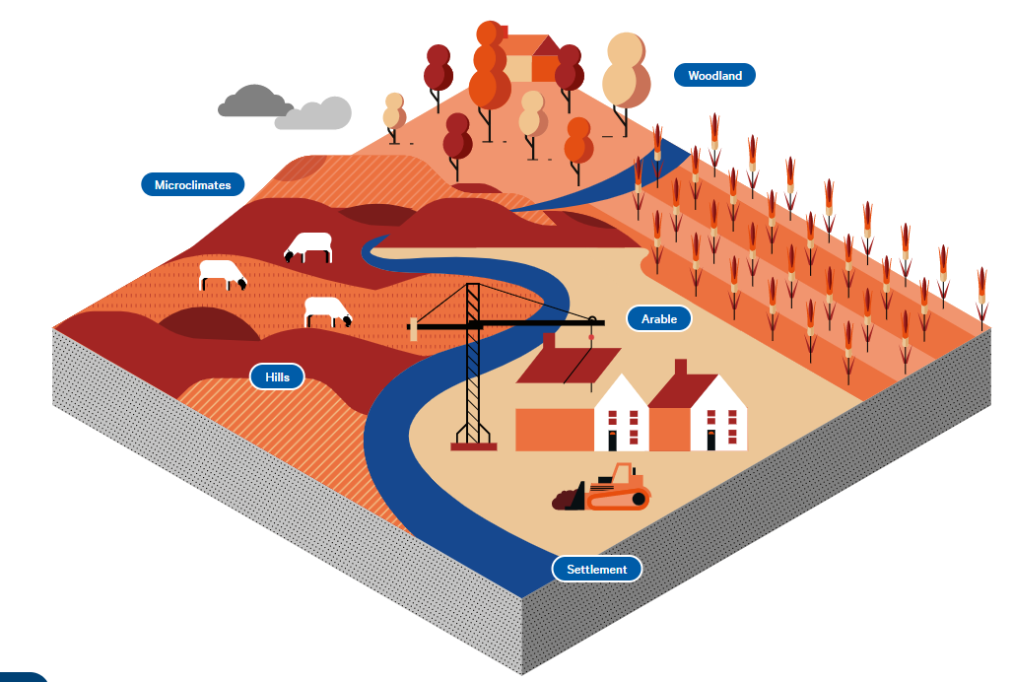
Landuse…
Represent spatial information on different types (classes) of physical coverage of the Earth's surface, e.g. forests, grasslands, croplands, lakes, wetlands.
Common sources
ESA CCI Land cover
Global Land Cover Characterization (GLCC)
Moderate Resolution Imaging Spectroradiometer (MODIS)
LUH2 – Land use Harmonization project
8
Notes:
Other sources e.g Wapor

Slide 9
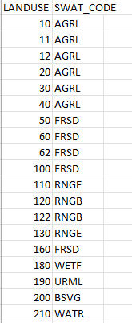
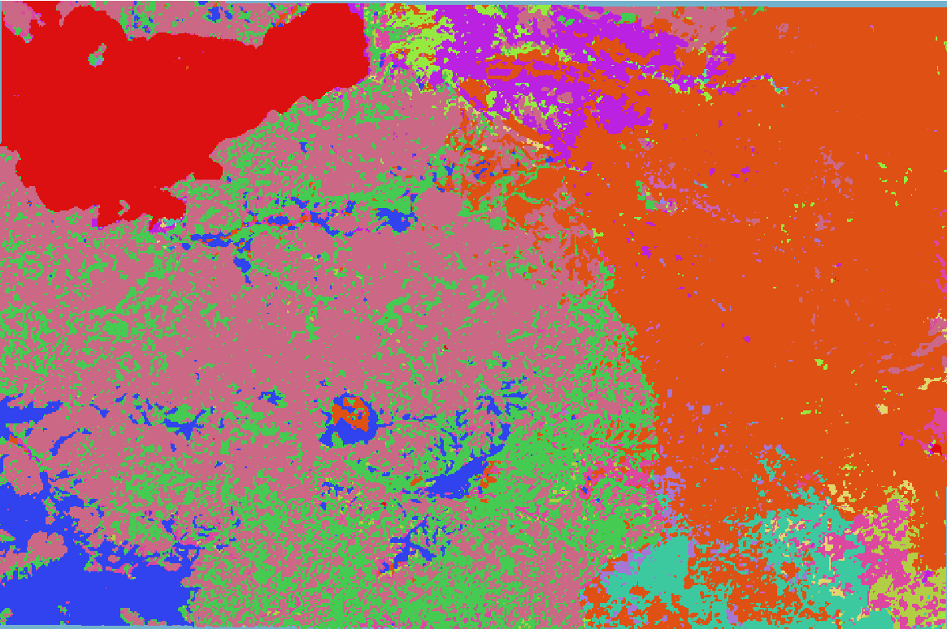
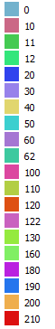
Landuse…(e.g)
SWAT landuse lookup table (.csv)
Raster landuse
Landuse ID
9
Notes:
Other sources e.g Wapor

Slide 10

Climate…
Rainfall, Temperature, Relative Humidity, Solar Radiation, Windspeed
Common sources
ISIMIP – Inter-Sectoral Impact Model Intercomparison Project
CDS – Climate Data Store (Rainfall + Temperature)
Many global precipitation datasets check this review (Sun et al. 2017)
10

Slide 11
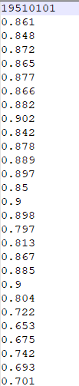
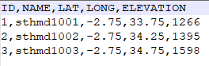
Climate…(e.g)
Rainfall, Temperature, Relative Humidity, Solar Radiation, Windspeed
sthmd1001.txt (Relative humidity)
hmd.txt (Relative humidity)
11

Slide 12
Other input data

Slide 13
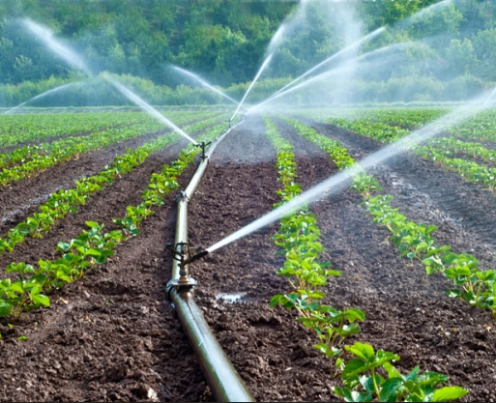
Crop phenology…
Cropping dates and cropping cycles
Common sources
Global Gridded Crop Model Intercomparisons (GGCMI)
Multiple cropping systems (Waha et. al 2020)
SAGE
Many global cropping datasets check this review (Kim et al., 2021)
13

Slide 14
Irrigation…
Irrigated areas
Common sources
FAO irrigated areas (Siebert et al., 2013)
New Global irrigated areas dataset (Nagaraj et al. 2021)
14

Slide 15

Fertilizer & Manure…
Elemental nitrogen and phosphorus
Common sources
ISIMIP N-fertilizer
Spatial Patterns of Global Fertilizer Application and Manure Production (Potter et al., 2010) (Zhang et al., 2017)
Global data on fertilizer use by crop and by country (Ludemann et al., 2022)
15

Slide 16
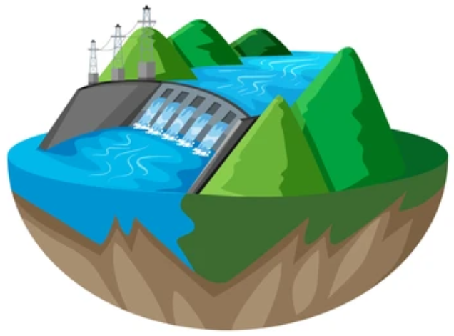
Resevoirs…
Global Location of reservoirs and reservoir characteristics
Common sources
Global Reservoir and Dam (GRanD) database (Lehner et al., 2011)
16

Slide 17
Evaluation data

Slide 18

Discharge…
Global Location of gauge stations
Common sources
Global Runoff Data Centre (GRDC; http://grdc.bafg.de)
18
Notes:
Monthly timestep

Slide 19
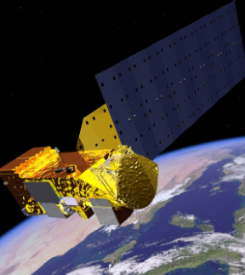
Evapotranspiration (ET)…
ET is the dominant component of the global water and energy cycle
Common sources
MODIS
GRACE Satellite Observations
GLEAM
19
Notes:
Regional ones like WaPoR

Slide 20
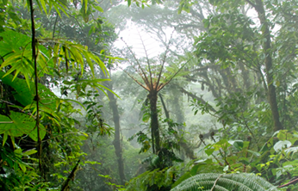
Leaf Area Index (LAI)…
Half the total area of green elements of the canopy per unit horizontal ground area
Common sources
MODIS
Copernicus Global Land Service
20
Notes:
Regional ones like WaPoR

Slide 21
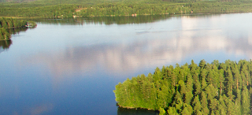
Water Quality…
Lake Turbidity, Chlorophyll-a, temperature
Common sources
Copernicus Global Land Service (https://land.copernicus.eu/global/products/lwq)
ESA climate office (https://climate.esa.int/en/projects/lakes/)
21
Notes:
Regional ones like WaPoR

Slide 22
Limitation(s)
Most of the data are at a coarse resolution (0.5 degrees)
Most of the data are gridded (need preprocessing)

Slide 24
Any Questions?

Slide 25
Steps in Data preparation

Slide 26
Prepare a shape file for your study area with a buffer around your catchment
Prepare the DEM, landuse and soil in the same correct CRS
Prepare the weather data in the right format (either SWAT2012 or SWAT+ format)

Slide 27
Home work
1. You will be given a Shapefile for a Study Area
(i) Create and account USGS Earth Explorer
(ii) Upload a shapefile in compressed (.zip) format
(iii) Select the area of interest
(iv) Select the data of interest e.g. DEM -> SRTM -> void filled
(v) Download the raster tiles
(vi) Merge the raster tiles into one raster file (DEM)
(vii) Project to the right CRS

Slide 28
Home work
2. Prepare the land use data of the Study Area
(i) Download land use map from ESA (select year) and clip it to study area
https://www.esa-landcover-cci.org/
(global map for 2015 has also been provided on canvas)
(ii) Look at the user guide for the land classification
(iii) Clip the map to an area of interest
(iv) Create a SWAT land use classification using the table in the link
https://oldgeni.isnew.info/landuse.html
(v) Project the map to the correct CRS

Slide 29
Home work
3. Prepare the climate data for the Study Area
4. Get Observation data if available for your study area
5. Get Soil Data for the area

